Slide 1
Research of Minsk bakeries

Slide 2
Target audience of this research:
It's definitely people who interested in opening bakery and looking for district to open place.
In my mind this person should consider how many bakeries Minsk has now and how peoples rated it.
Opening hours in my opinion also important because I and my colleagues and friends really likes to buy fresh croissant and morning coffee when we're going to work.

Slide 3
Plan of my research:
Download the data – this part is concluding creating of data frame with information about districts of Minsk and it coordinates.
Using API Foursquare I should to know id of bakeries category for searching all company this type and get full their information. *
Join all data into one data frame including information about each company and it’s district.
Deleting duplicate rows, transforming columns.
Analyze it and appending on map.
Using K-Means create model and fit it on data frame.
Give a conclusion.
Data description of research:
Open source data about Minsk districts from yandex map.
API foursquare to find all bakeries of Minsk.

Slide 4
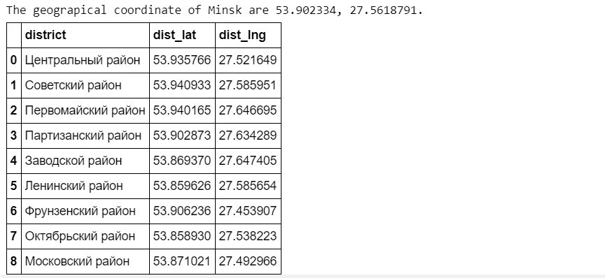
Methodology section
Using libraries: pandas, numpy, requests, json, geodesic, translit etc.
Machine learning techniques: K-means for clustering data.
The information about Minsk and it districts.

Slide 5
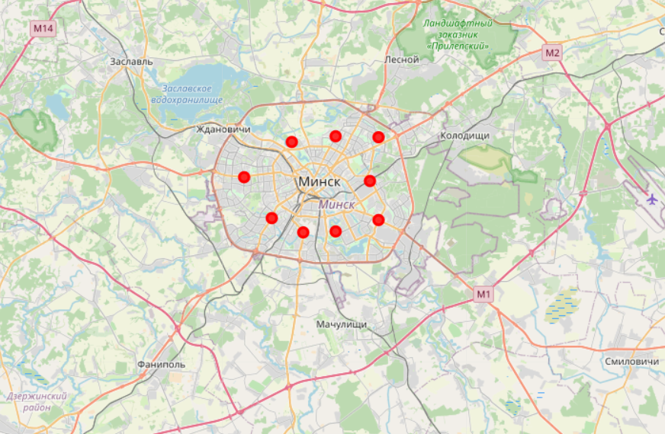
Map of Minsk with districts superimposed on top

Slide 6
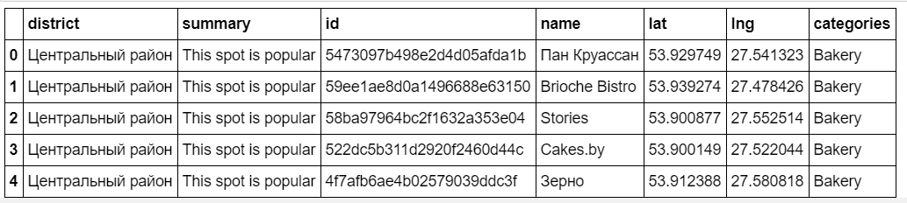
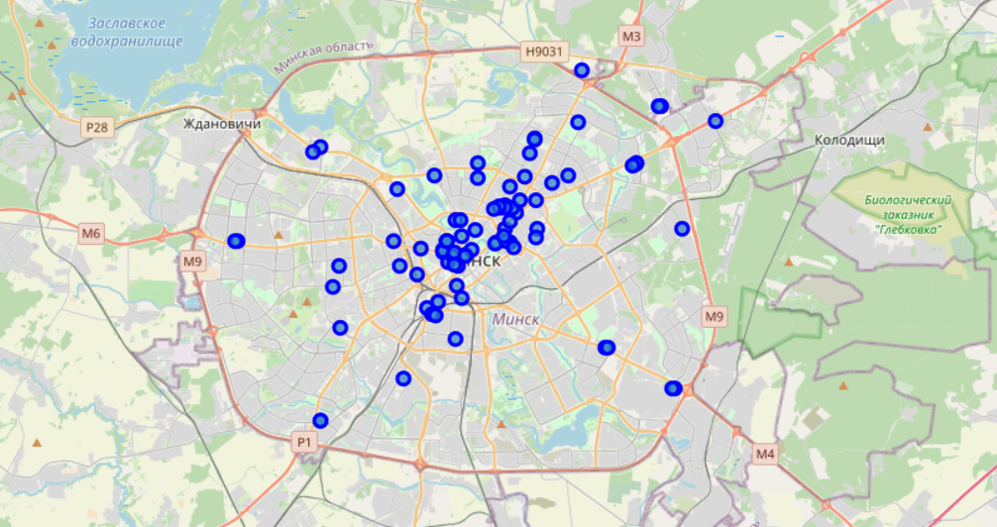
Parts of data frame from API Foursquare

Slide 7
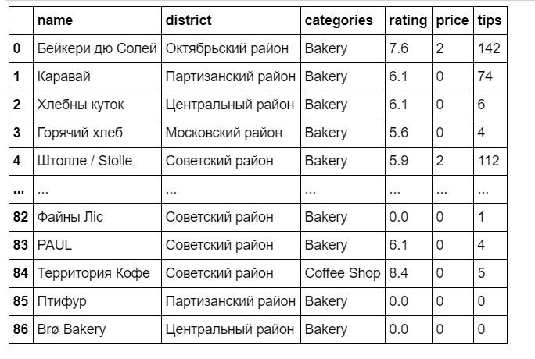
Part of data frame with some columns to analyze

Slide 8
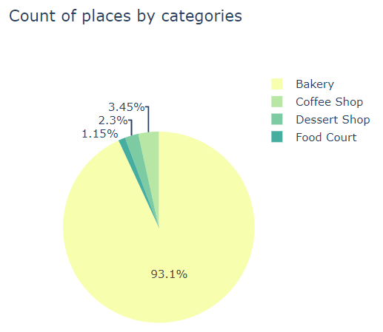
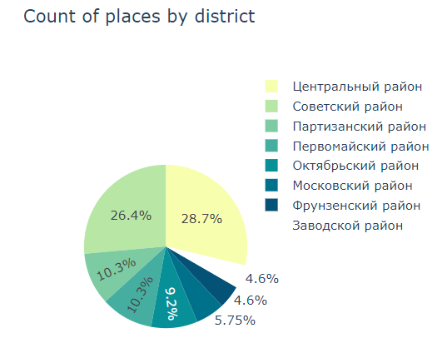
Plots of data frame trough by district and category

Slide 9

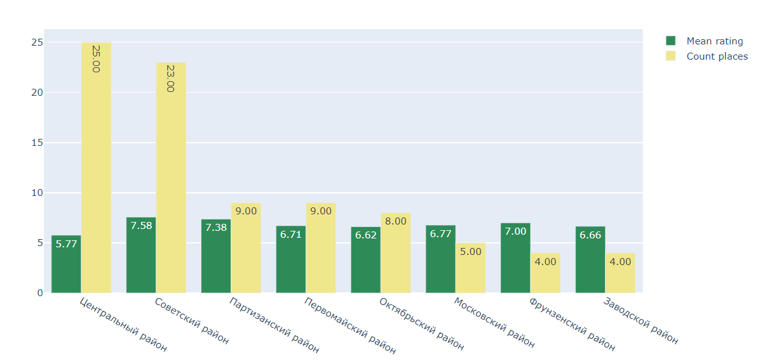
Mean rating and count likes of places by district

Slide 10
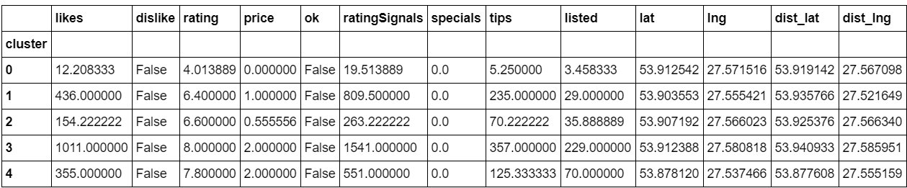
Using K-Means algorithm fit our model to cluster data frame to 5 categories Looking the mean value of each cluster below:
As we seen the best mean value of rating, prices and likes has 3 and 4 clusters. This bakeries definitely should visit.

Slide 11
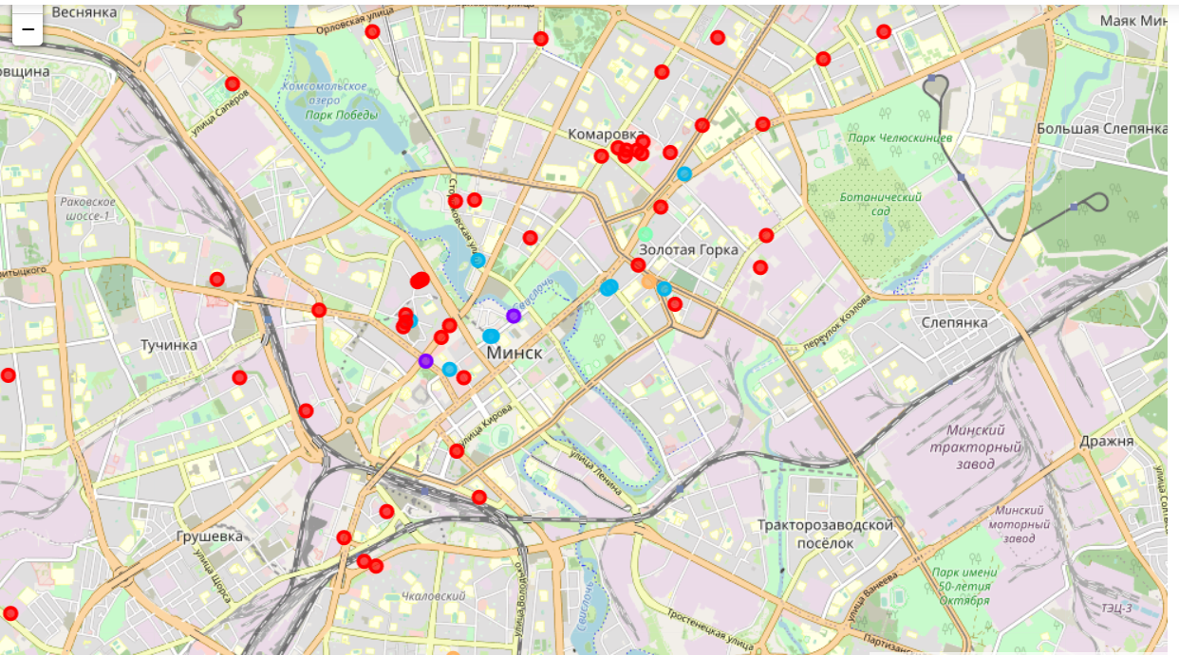
Adding places on map using color scheme for different clusters:

Slide 12
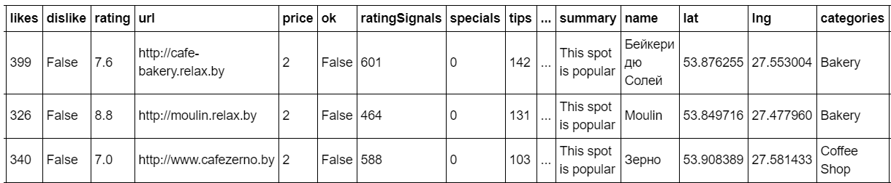
The best bakeries in Minsk according to model:

Slide 13
Answering to the question:
'Which Minsk district really need more bakeries?‘
I should notice that most count of bakeries belong to the center of city and central district.
And it's okay because most of cultural and evening life are using there, all European cities has the same statistic.
But according to my question - bakery for me, it's firstly the morning coffee and croissant and I defiantly recommend to open bakeries not in the center of city, but in the new districts far from the center.
Really great example we can see at 'Moulin' bakery which is according to the high 4 cluster. From all 87 Minsk's bakeries just 3 from it has 4 cluster and it place is situated to new district.

